Slide 1
Subject | LANGUAGE
Grade | 3 YEAR 2
Term | 3

Slide 2
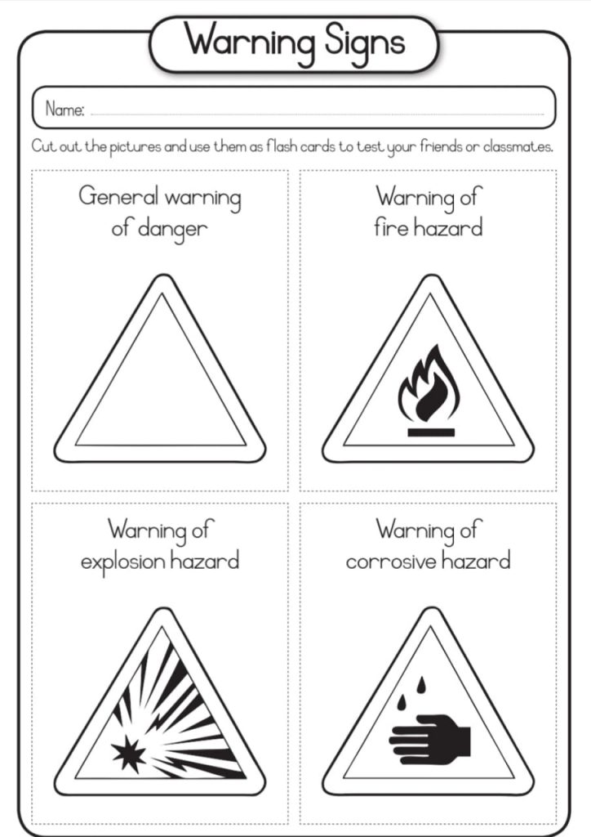
PUBLIC SAFETY
GROUP 1

Slide 3
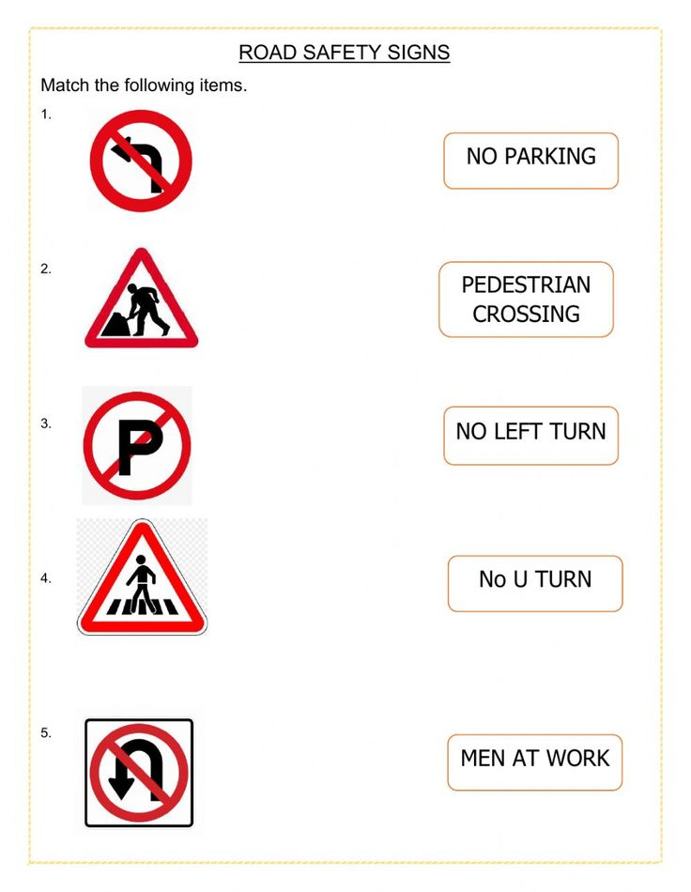
PUBLIC SAFETY

Slide 4
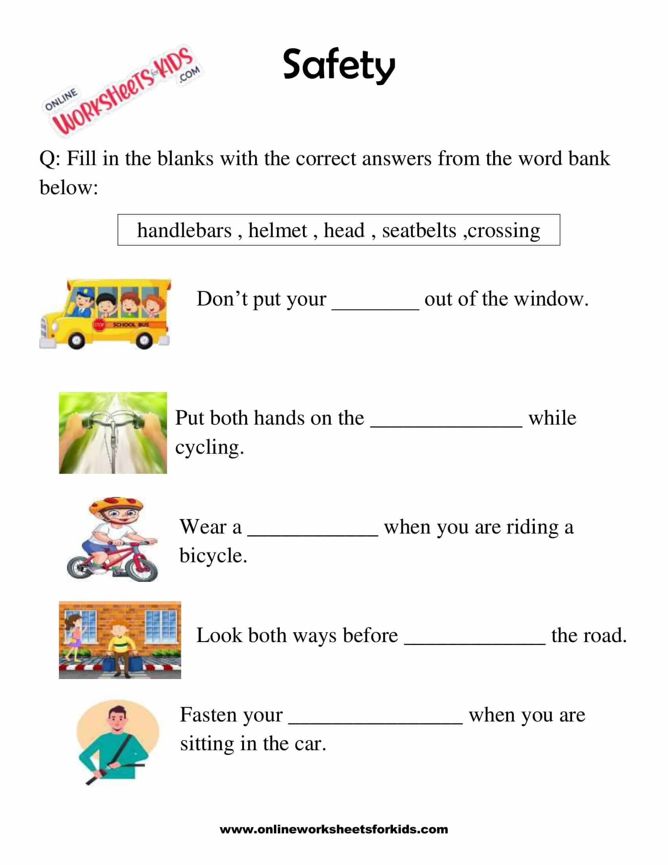
PUBLIC SAFETY
Group 2

Slide 5
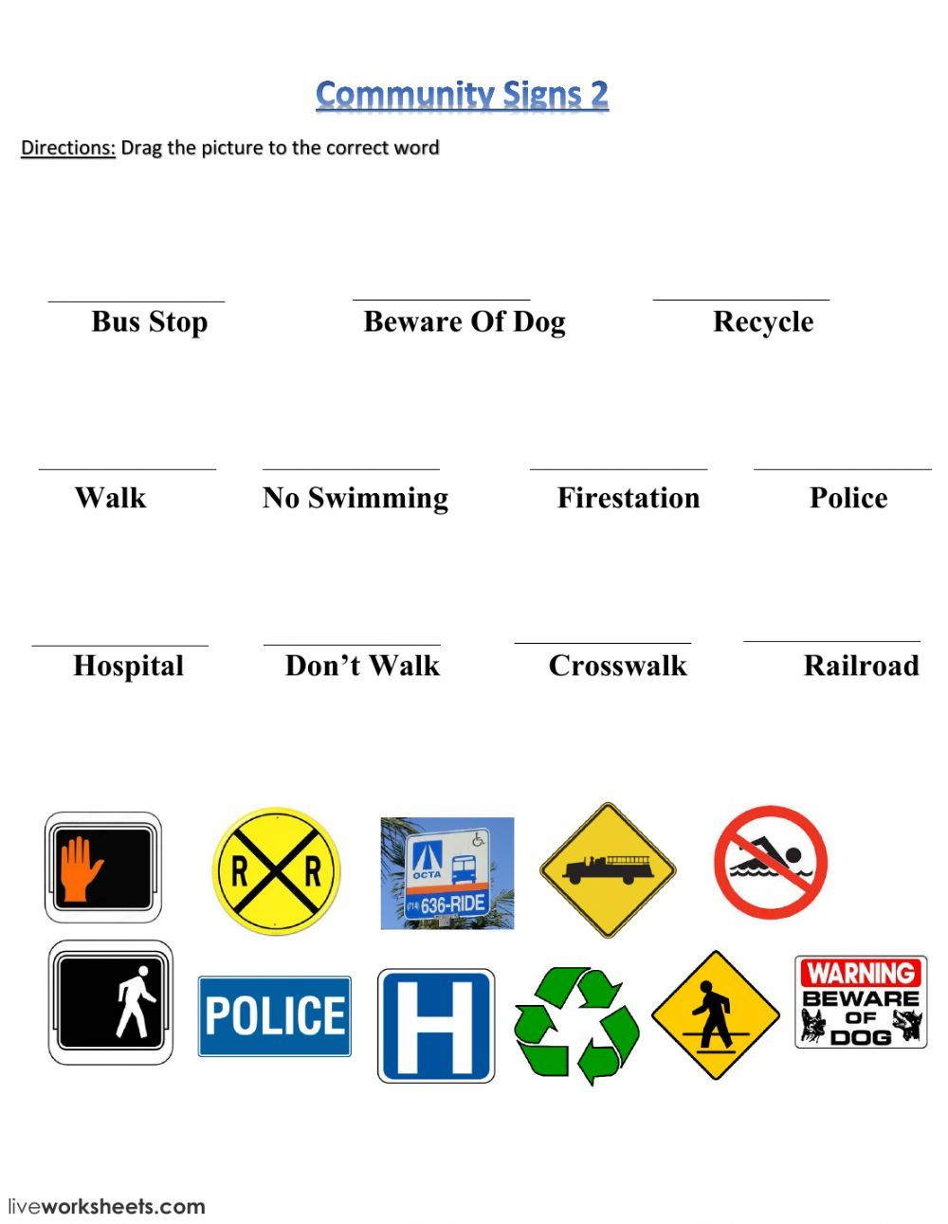
Public safety
Group 2

Slide 6
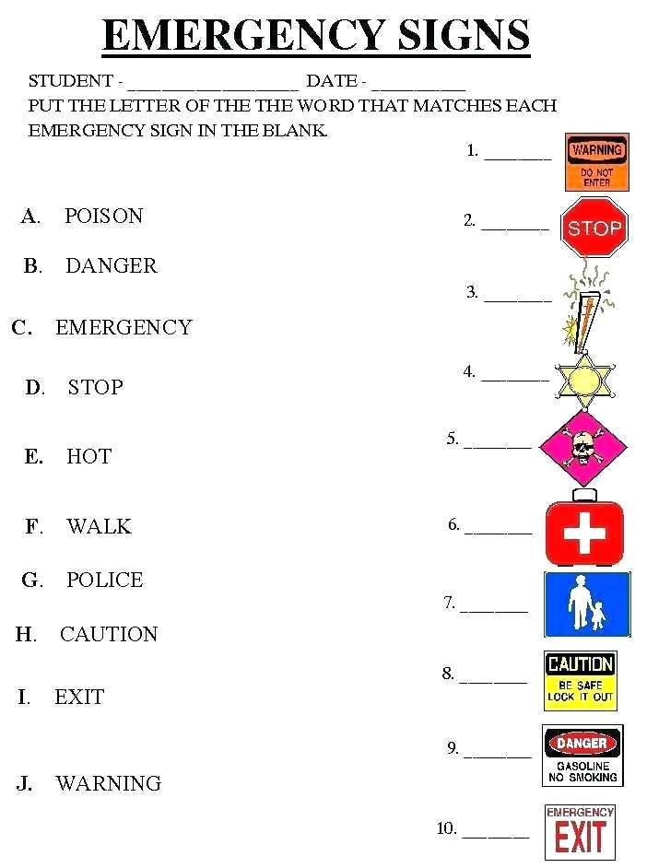
Public safety
Group 3

Slide 7
Public safety
Group 3

Slide 8
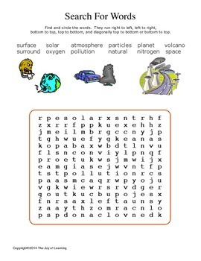
Pollution
GROUP 1

Slide 9
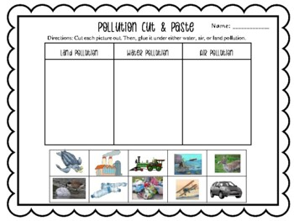
POLLUTION
GROUP 1

Slide 10
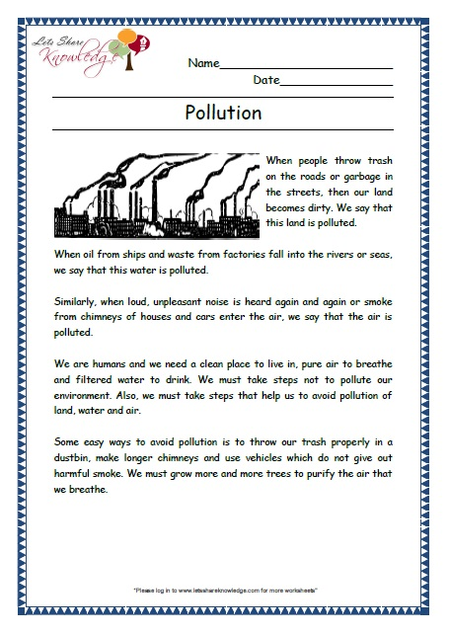
POLLUTION
GROUP 2
LEARNERS ARE REQUIRED TO CHOOSE AND HIGHLIGHT WORDS THAT HAVE THE SAME CONSONANT DIAGRAPHS AT THE BEGINNING OF EACH WORD

Slide 11
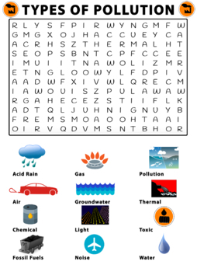
POLLUTION
GROUP 2

Slide 12
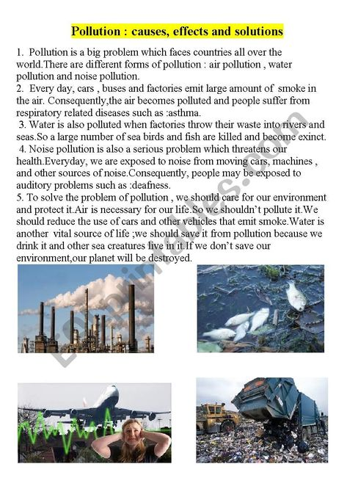
POLLUTION
GROUP 3
LEARNERS ARE REQUIRED TO CHOOSE AND HIGHLIGHT WORDS THAT HAVE THE SAME CONSONANT DIAGRAPHS AT THE BEGINNING OF EACH WORD

Slide 13
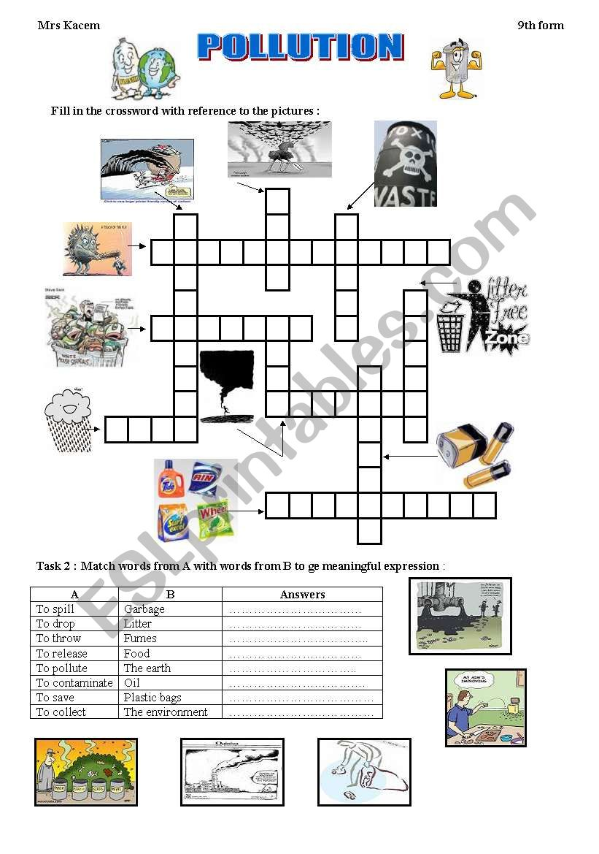
POLLUTION

Slide 14
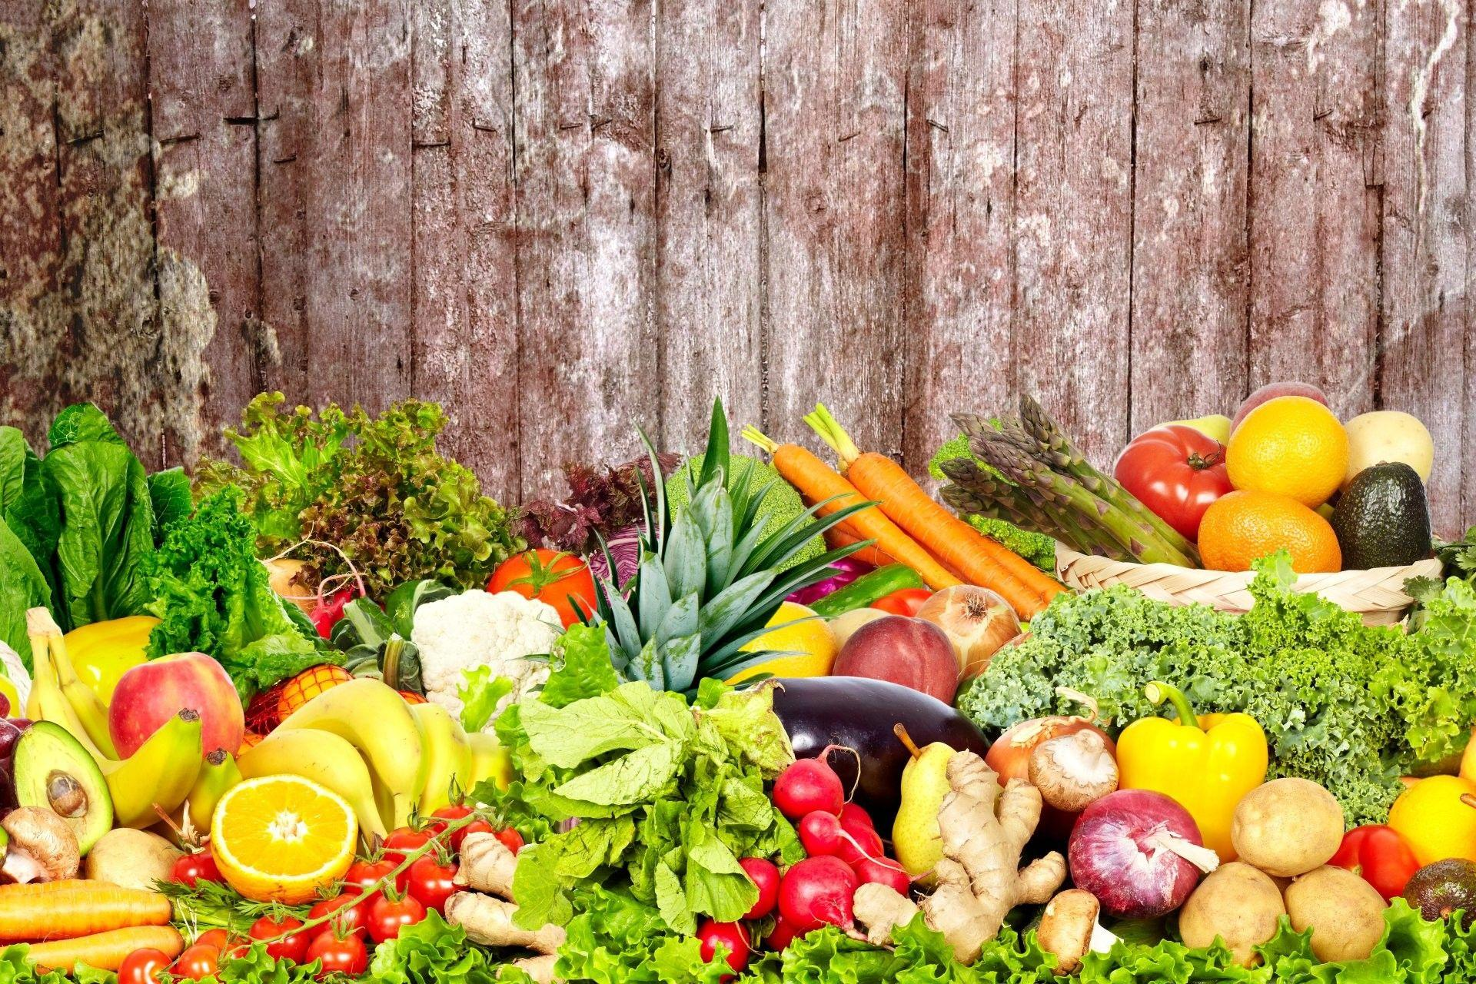
Fruits and vegetables

Slide 15
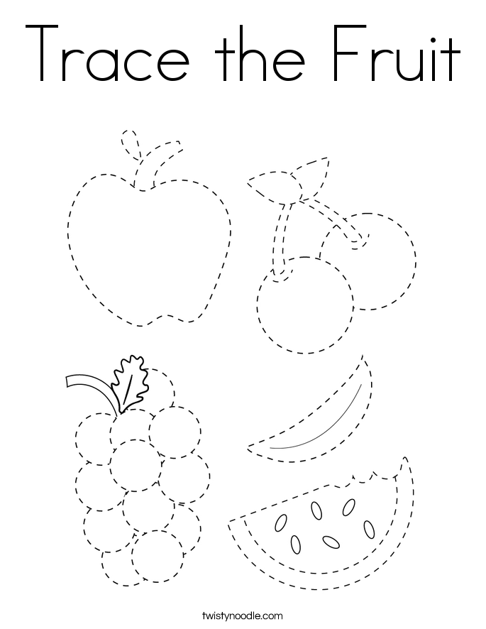
Fruits and vegetables
Group 1

Slide 16
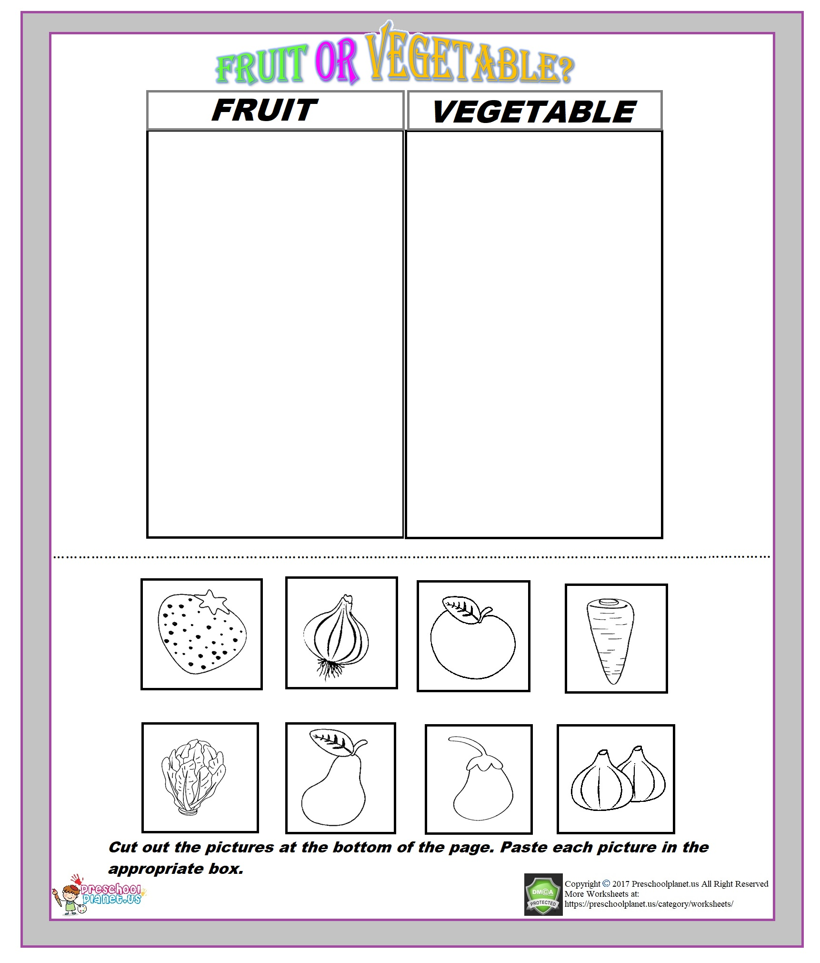
Fruits and vegetables

Slide 17
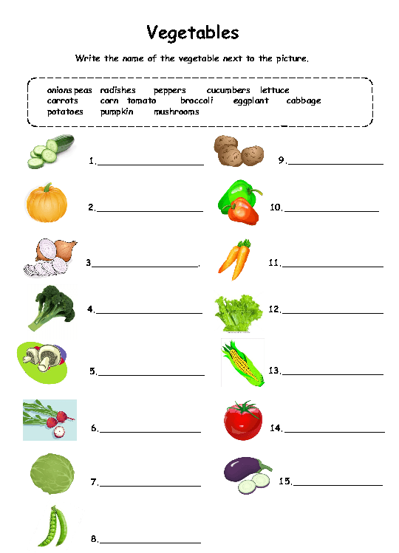
Fruits and vegetables
Group 2

Slide 18
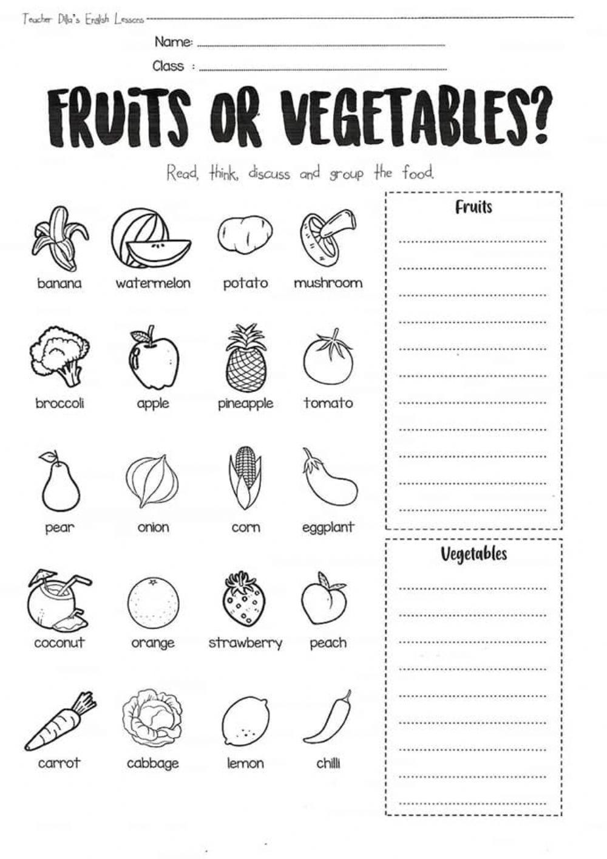
Fruits and vegetables
Group 3

Slide 19
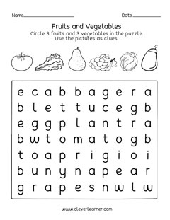
Fruits and vegetables
Group 3

